Slide 1
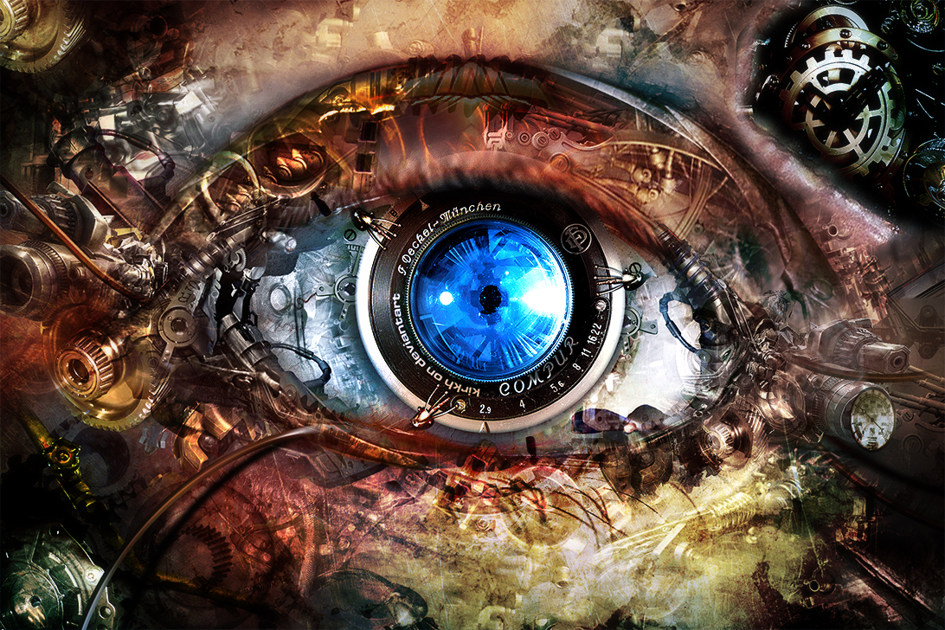
6.S093 Visual Recognition through Machine Learning Competition
Aditya Khosla and Joseph Lim
Image by kirkh.deviantart.com

Slide 2
Today’s class
Part 1: Introduction to deep learning
What is deep learning?
Why deep learning?
Some common deep learning algorithms
Part 2: Deep learning tutorial
Please install Python++ now!

Slide 3
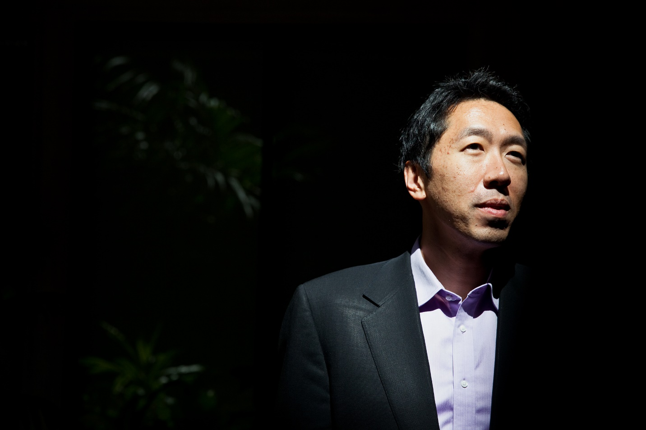
Slide credit
Many slides are taken/adapted from Andrew Ng’s

Slide 4
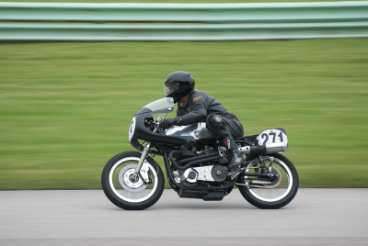
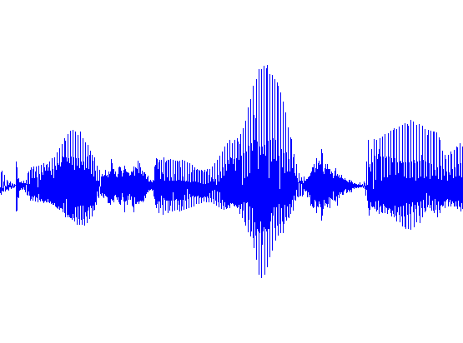

Typical goal of machine learning
input
output
Label: “Motorcycle”
Suggest tags
Image search
…
images/video
ML
Speech recognition
Music classification
Speaker identification
…
audio
ML
Web search
Anti-spam
Machine translation
…
text
ML

Slide 5
Typical goal of machine learning
Feature engineering: most time consuming!
input
output
Label: “Motorcycle”
Suggest tags
Image search
…
images/video
ML
Speech recognition
Music classification
Speaker identification
…
audio
ML
Web search
Anti-spam
Machine translation
…
text
ML

Slide 6
Our goal in object classification
ML
“motorcycle”

Slide 7
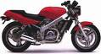
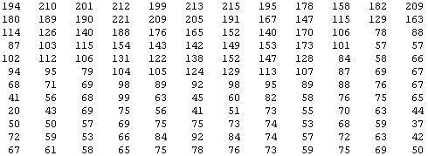
Why is this hard?
You see this:
But the camera sees this:

Slide 8
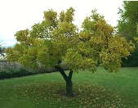
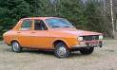

Pixel-based representation
pixel 1
Learning
algorithm
pixel 2
Input
Motorbikes
Raw image
“Non”-Motorbikes
pixel 2
pixel 1

Slide 9
Pixel-based representation
pixel 1
Learning
algorithm
pixel 2
Input
Motorbikes
Raw image
“Non”-Motorbikes
pixel 2
pixel 1

Slide 10
Pixel-based representation
pixel 1
Learning
algorithm
pixel 2
Input
Motorbikes
Raw image
“Non”-Motorbikes
pixel 2
pixel 1

Slide 11
What we want
handlebars
Feature representation
Learning
algorithm
wheel
Input
E.g., Does it have Handlebars? Wheels?
Motorbikes
Raw image
“Non”-Motorbikes
Features
pixel 2
Wheels
pixel 1
Handlebars

Slide 12
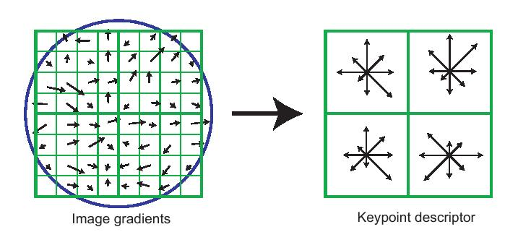
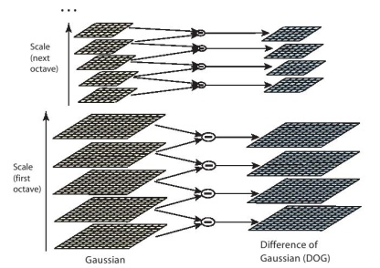
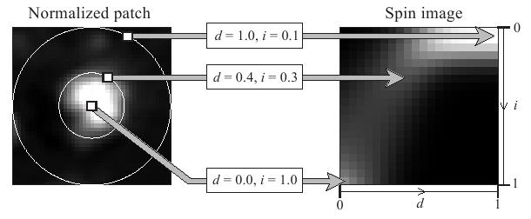
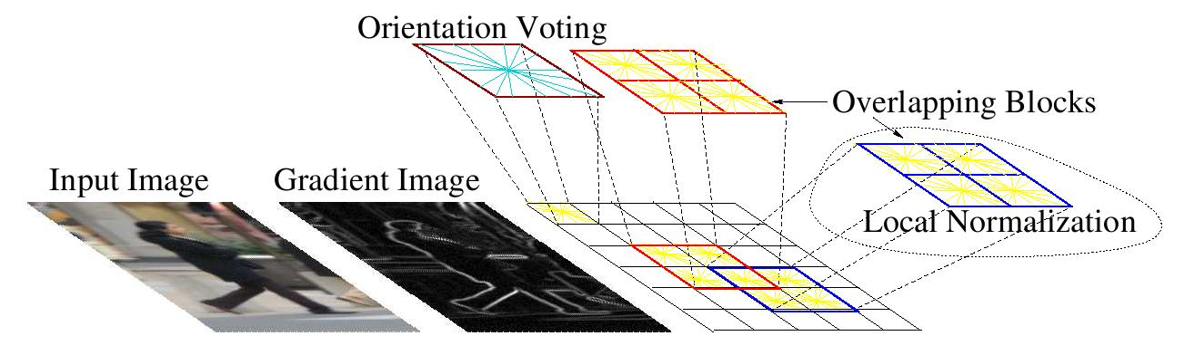
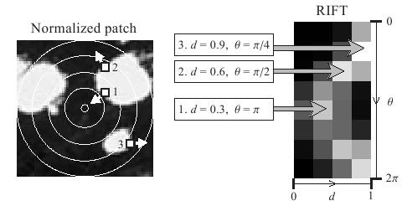
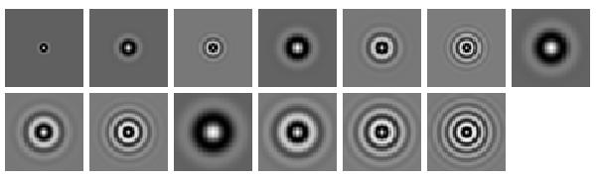
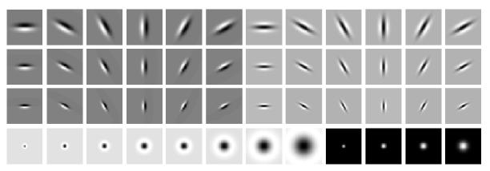
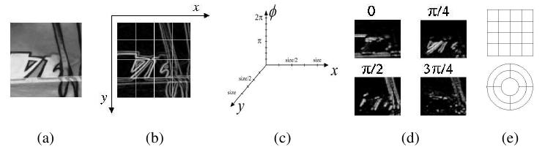
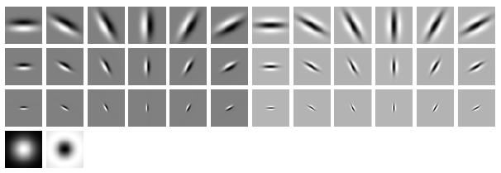
Some feature representations
SIFT
Spin image
HoG
RIFT
Textons
GLOH

Slide 13
Some feature representations
Coming up with features is often difficult, time-consuming, and requires expert knowledge.
SIFT
Spin image
HoG
RIFT
Textons
GLOH

Slide 14

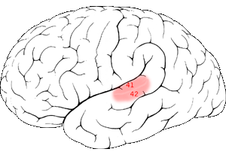
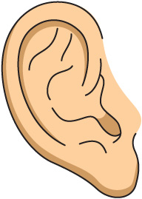
The brain: potential motivation for deep learning
Auditory Cortex
Auditory cortex learns to see!
[Roe et al., 1992]

Slide 15
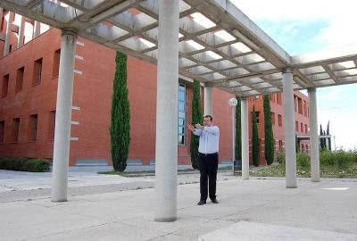
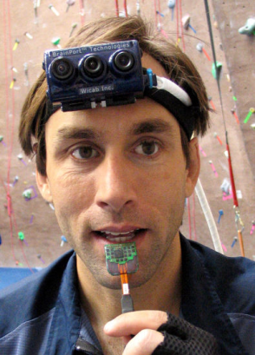
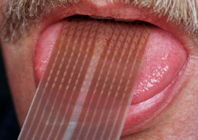
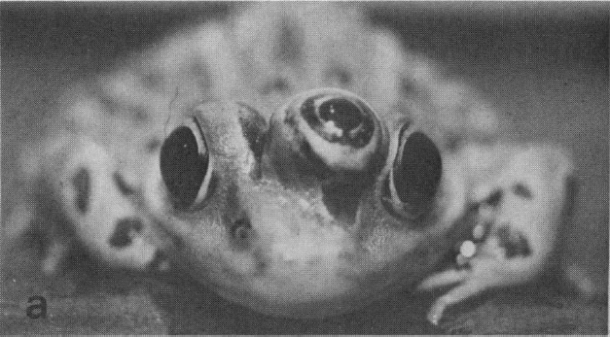
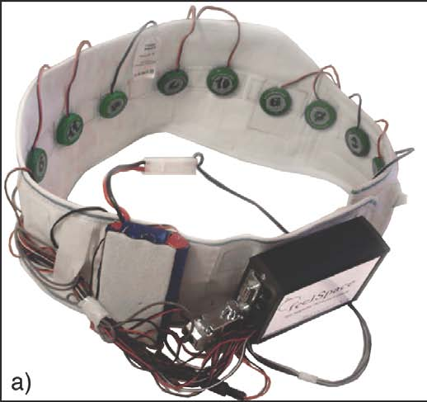
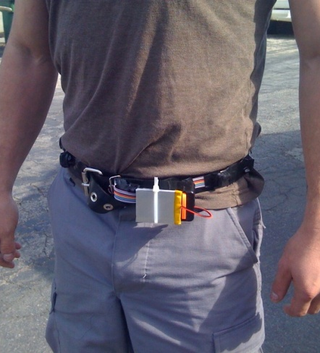
The brain adapts!
Seeing with your tongue
Human echolocation (sonar)
Haptic belt: Direction sense
Implanting a 3rd eye
[BrainPort; Welsh & Blasch, 1997; Nagel et al., 2005; Constantine-Paton & Law, 2009]

Slide 16
Basic idea of deep learning
Also referred to as representation learning or unsupervised feature learning (with subtle distinctions)
Is there some way to extract meaningful features from data even without knowing the task to be performed?
Then, throw in some hierarchical ‘stuff’ to make it ‘deep’

Slide 17

Feature learning problem
Given a 14x14 image patch x, can represent it using 196 real numbers.
Problem: Can we find a learn a better feature vector to represent this?
255
98
93
87
89
91
48
…

Slide 18
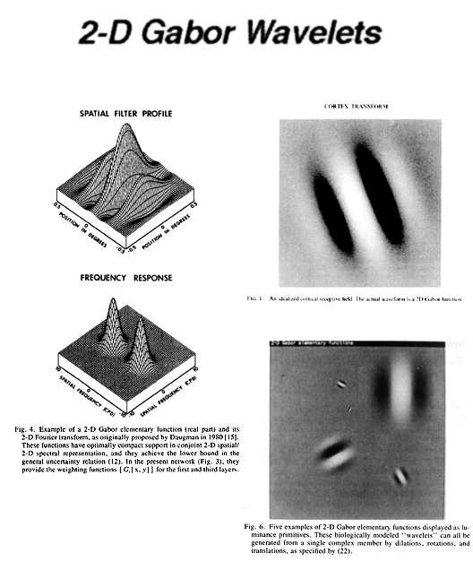
First stage of visual processing: V1
V1 is the first stage of visual processing in the brain.
Neurons in V1 typically modeled as edge detectors:
Neuron #1 of visual cortex
(model)
Neuron #2 of visual cortex
(model)
Notes:
http://www.ldeo.columbia.edu/4d4/wavelets/dm.html

Slide 19

Learning sensor representations
Sparse coding (Olshausen & Field,1996)
Input: Images x⁽¹⁾, x⁽²⁾, …, x^{(m)} (each in R^{n x n})
Learn: Dictionary of bases φ₁, φ₂, …, φ_{k} (also R^{n x n}), so that each input x can be approximately decomposed as:
x ∑ a_{j} φ_{j}
s.t. a_{j}’s are mostly zero (“sparse”)
^{k}
^{j=1}

Slide 20
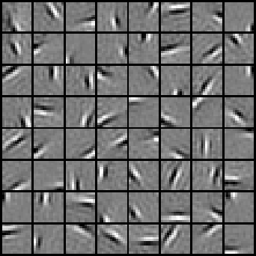
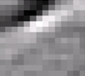

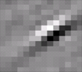


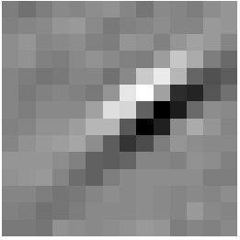
Sparse coding illustration
Natural Images
Learned bases (φ_{1 , …,} φ₆₄): “Edges”
Test example
≈ 0.8 * + 0.3 * + 0.5 *
x ≈ 0.8 * φ₃₆ + 0.3 * φ₄₂ + 0.5 * φ₆₃
[a₁, …, a₆₄] = [0, 0, …, 0, 0.8, 0, …, 0, 0.3, 0, …, 0, 0.5, 0]
(feature representation)

Slide 21


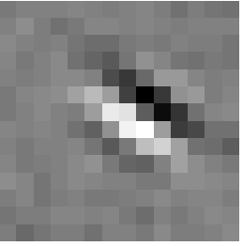






Sparse coding illustration
Represent as: [a₁₅=0.6, a₂₈=0.8, a₃₇ = 0.4]
0.6 * + 0.8 * + 0.4 *
φ₁₅ φ₂₈ φ₃₇
Represent as: [a₅=1.3, a₁₈=0.9, a₂₉ = 0.3]
1.3 * + 0.9 * + 0.3 *
φ₅ φ₁₈ φ₂₉
Method “invents” edge detection
Automatically learns to represent an image in terms of the edges that appear in it. Gives a more succinct, higher-level representation than the raw pixels.
Quantitatively similar to primary visual cortex (area V1) in brain.

Slide 22


Going deep
object models
object parts
(combination
of edges)
edges
Training set: Aligned
images of faces.
pixels
[Honglak Lee]

Slide 23
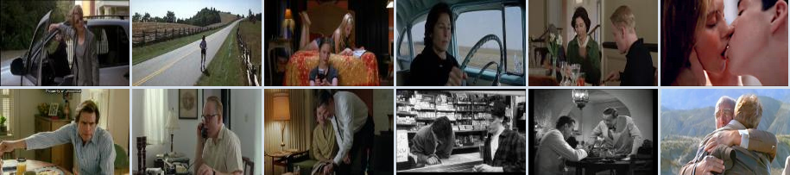
Why deep learning?
Task: video activity recognition
Method | Accuracy
Hessian + ESURF [Williems et al 2008] | 38%
Harris3D + HOG/HOF [Laptev et al 2003, 2004] | 45%
Cuboids + HOG/HOF [Dollar et al 2005, Laptev 2004] | 46%
Hessian + HOG/HOF [Laptev 2004, Williems et al 2008] | 46%
Dense + HOG / HOF [Laptev 2004] | 47%
Cuboids + HOG3D [Klaser 2008, Dollar et al 2005] | 46%
Unsupervised feature learning (our method) | 52%
[Le, Zhou & Ng, 2011]

Slide 24
Audio
TIMIT Phone classification | Accuracy
Prior art (Clarkson et al.,1999) | 79.6%
Feature learning | 80.3%
TIMIT Speaker identification | Accuracy
Prior art (Reynolds, 1995) | 99.7%
Feature learning | 100.0%
Images
CIFAR Object classification | Accuracy
Prior art (Ciresan et al., 2011) | 80.5%
Feature learning | 82.0%
NORB Object classification | Accuracy
Prior art (Scherer et al., 2010) | 94.4%
Feature learning | 95.0%
Galaxy
Video
Hollywood2 Classification | Accuracy
Prior art (Laptev et al., 2004) | 48%
Feature learning | 53%
YouTube | Accuracy
Prior art (Liu et al., 2009) | 71.2%
Feature learning | 75.8%
KTH | Accuracy
Prior art (Wang et al., 2010) | 92.1%
Feature learning | 93.9%
UCF | Accuracy
Prior art (Wang et al., 2010) | 85.6%
Feature learning | 86.5%
Text/NLP
Multimodal (audio/video)
AVLetters Lip reading | Accuracy
Prior art (Zhao et al., 2009) | 58.9%
Stanford Feature learning | 65.8%
Paraphrase detection | Accuracy
Prior art (Das & Smith, 2009) | 76.1%
Feature learning | 76.4%
Sentiment (MR/MPQA data) | Accuracy
Prior art (Nakagawa et al., 2010) | 77.3%
Feature learning | 77.7%

Slide 25
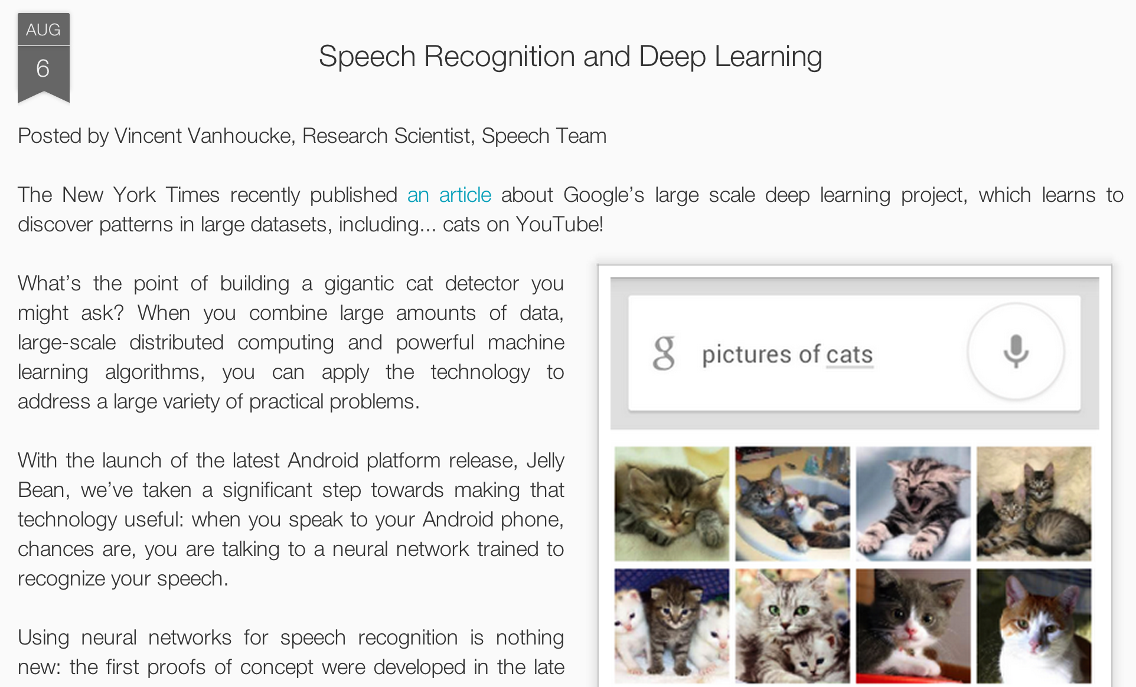
Speech recognition on Android

Slide 26
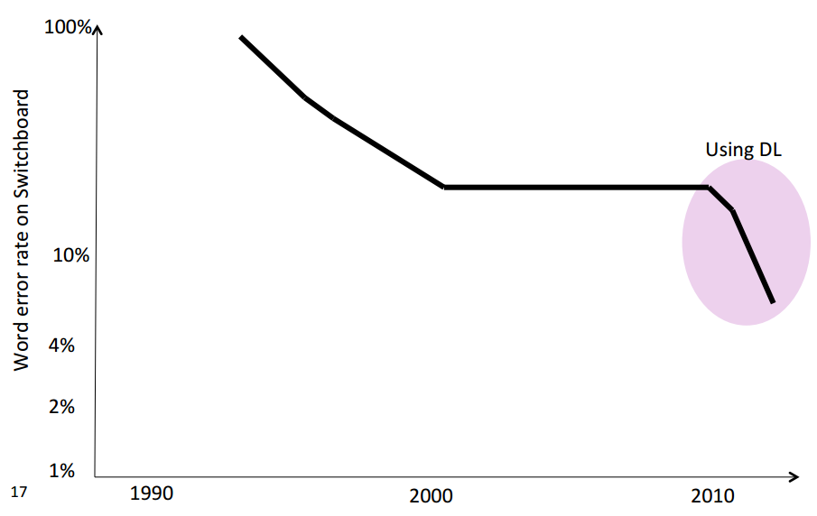
Impact on speech recognition

Slide 27
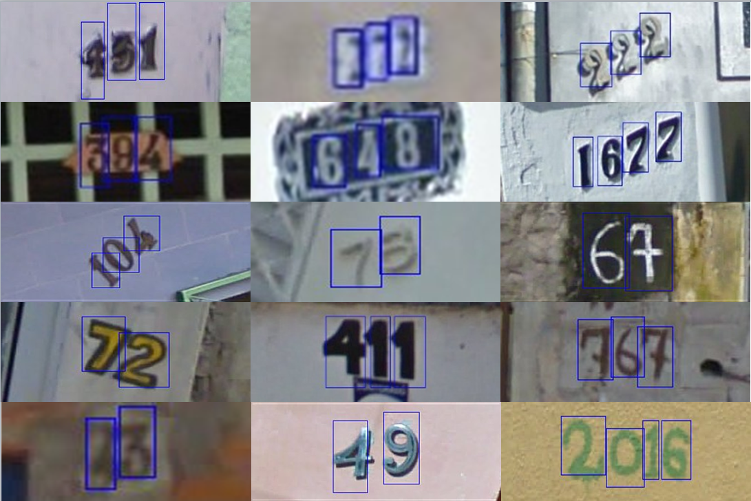
Application to Google Streetview

Slide 28
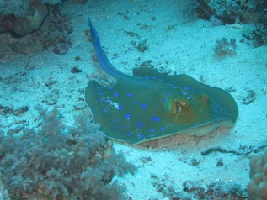
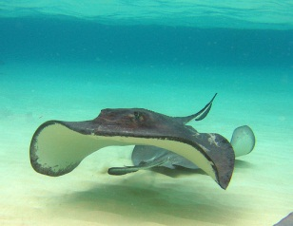
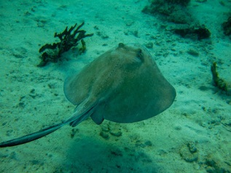
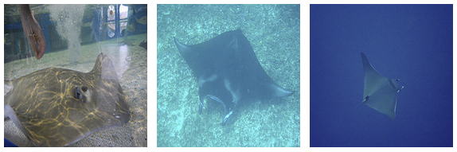
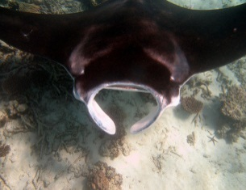
ImageNet classification: 22,000 classes
…
smoothhound, smoothhound shark, Mustelus mustelus
American smooth dogfish, Mustelus canis
Florida smoothhound, Mustelus norrisi
whitetip shark, reef whitetip shark, Triaenodon obseus
Atlantic spiny dogfish, Squalus acanthias
Pacific spiny dogfish, Squalus suckleyi
hammerhead, hammerhead shark
smooth hammerhead, Sphyrna zygaena
smalleye hammerhead, Sphyrna tudes
shovelhead, bonnethead, bonnet shark, Sphyrna tiburo
angel shark, angelfish, Squatina squatina, monkfish
electric ray, crampfish, numbfish, torpedo
smalltooth sawfish, Pristis pectinatus
guitarfish
roughtail stingray, Dasyatis centroura
butterfly ray
eagle ray
spotted eagle ray, spotted ray, Aetobatus narinari
cownose ray, cow-nosed ray, Rhinoptera bonasus
manta, manta ray, devilfish
Atlantic manta, Manta birostris
devil ray, Mobula hypostoma
grey skate, gray skate, Raja batis
little skate, Raja erinacea
…
Stingray
Mantaray

Slide 29
ImageNet Classification: 14M images, 22k categories
0.005%
9.5%
?
Random guess
State-of-the-art
(Weston, Bengio ‘11)
Feature learning
From raw pixels
Le, et al., Building high-level features using large-scale unsupervised learning. ICML 2012

Slide 30
ImageNet Classification: 14M images, 22k categories
0.005%
9.5%
21.3%
Random guess
State-of-the-art
(Weston, Bengio ‘11)
Feature learning
From raw pixels
Le, et al., Building high-level features using large-scale unsupervised learning. ICML 2012

Slide 31
Some common deep architectures
Autoencoders
Deep belief networks (DBNs)
Convolutional variants
Sparse coding

Slide 32


Logistic regression
Logistic regression has a learned parameter vector θ.
On input x, it outputs:
where
x₁
Draw a logistic
regression unit as:
x₂
x₃
+1

Slide 33

Neural Network
String a lot of logistic units together. Example 3 layer network:
x₁
a₁
x₂
a₂
a₃
x₃
Layer 3
+1
+1
Layer 1
Layer 3

Slide 34
Neural Network
Example 4 layer network with 2 output units:
x₁
x₂
x₃
+1
Layer 4
+1
+1
Layer 3
Layer 1
Layer 2

Slide 35
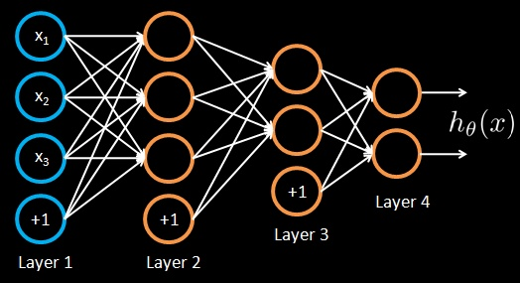

Training a neural network
Given training set (x₁, y₁), (x₂, y₂), (x₃, y₃ ), ….
Adjust parameters θ (for every node) to make:
(Use gradient descent. “Backpropagation” algorithm. Susceptible to local optima.)

Slide 36

Unsupervised feature learning with a neural network
Autoencoder.
Network is trained to output the input (learn identify function).
Trivial solution unless:
Constrain number of units in Layer 2 (learn compressed representation), or
Constrain Layer 2 to be sparse.
x₁
x₁
x₂
x₂
a₁
x₃
x₃
a₂
x₄
x₄
a₃
x₅
x₅
+1
x₆
x₆
+1
Layer 2
Layer 3
Layer 1

Slide 37
Unsupervised feature learning with a neural network
x₁
x₁
x₂
x₂
a₁
x₃
x₃
a₂
x₄
x₄
a₃
x₅
x₅
+1
x₆
x₆
+1
Layer 2
Layer 3
Layer 1

Slide 38

Unsupervised feature learning with a neural network
x₁
x₂
a₁
x₃
a₂
x₄
a₃
x₅
+1
New representation for input.
x₆
+1
Layer 2
Layer 1

Slide 39
Unsupervised feature learning with a neural network
x₁
x₂
a₁
x₃
a₂
x₄
a₃
x₅
+1
x₆
+1
Layer 2
Layer 1

Slide 40

Unsupervised feature learning with a neural network
x₁
x₂
a₁
b₁
x₃
a₂
b₂
x₄
a₃
b₃
x₅
+1
+1
x₆
+1
Train parameters so that ,
subject to b_{i}’s being sparse.

Slide 41
Unsupervised feature learning with a neural network
x₁
x₂
a₁
b₁
x₃
a₂
b₂
x₄
a₃
b₃
x₅
+1
+1
x₆
+1
Train parameters so that ,
subject to b_{i}’s being sparse.

Slide 42
Unsupervised feature learning with a neural network
x₁
x₂
a₁
b₁
x₃
a₂
b₂
x₄
a₃
b₃
x₅
+1
+1
x₆
+1
Train parameters so that ,
subject to b_{i}’s being sparse.

Slide 43

Unsupervised feature learning with a neural network
x₁
x₂
a₁
b₁
x₃
a₂
b₂
x₄
a₃
b₃
x₅
+1
+1
New representation for input.
x₆
+1

Slide 44
Unsupervised feature learning with a neural network
x₁
x₂
a₁
b₁
x₃
a₂
b₂
x₄
a₃
b₃
x₅
+1
+1
x₆
+1

Slide 45

Unsupervised feature learning with a neural network
x₁
x₂
a₁
b₁
c₁
x₃
a₂
b₂
c₂
x₄
a₃
b₃
c₃
x₅
+1
+1
+1
x₆
+1

Slide 46

Unsupervised feature learning with a neural network
x₁
x₂
a₁
b₁
c₁
x₃
a₂
b₂
c₂
x₄
a₃
b₃
c₃
x₅
+1
+1
+1
New representation
for input.
x₆
+1
Use [c₁, c₃, c₃] as representation to feed to learning algorithm.

Slide 47
Deep Belief Net
Deep Belief Net (DBN) is another algorithm for learning a feature hierarchy.
Building block: 2-layer graphical model (Restricted Boltzmann Machine).
Can then learn additional layers one at a time.

Slide 48


Restricted Boltzmann machine (RBM)
a₁
a₂
a₃
Layer 2. [a_{1,} a₂, a₃]
(binary-valued)
x₁
x₂
x₃
x₄
Input [x_{1,} x₂, x₃, x₄]
MRF with joint distribution:
Use Gibbs sampling for inference.
Given observed inputs x, want maximum likelihood estimation:

Slide 49

Restricted Boltzmann machine (RBM)
a₁
a₂
a₃
Layer 2. [a_{1,} a₂, a₃]
(binary-valued)
x₁
x₂
x₃
x₄
Input [x_{1,} x₂, x₃, x₄]
Gradient ascent on log P(x) :
[x_{i}a_{j}]_{obs} from fixing x to observed value, and sampling a from P(a|x).
[x_{i}a_{j}]_{prior} from running Gibbs sampling to convergence.
Adding sparsity constraint on a_{i}’s usually improves results.

Slide 50
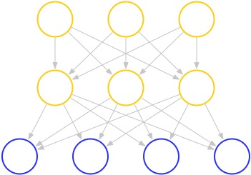

Deep Belief Network
Similar to a sparse autoencoder in many ways. Stack RBMs on top of each other to get DBN.
Layer 3. [b_{1,} b₂, b₃]
Layer 2. [a_{1,} a₂, a₃]
Input [x_{1,} x₂, x₃, x₄]
Train with approximate maximum likelihood (often with sparsity constraint on a_{i}’s):

Slide 51
Deep Belief Network
Layer 4. [c_{1,} c₂, c₃]
Layer 3. [b_{1,} b₂, b₃]
Layer 2. [a_{1,} a₂, a₃]
Input [x_{1,} x₂, x₃, x₄]
Notes:
End: One of challenges is scaling up. Most people: 14x14 up to 32x32.

Slide 52
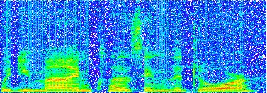
Convolutional DBN for audio
Max pooling unit
Detection units
Spectrogram

Slide 53
Convolutional DBN for audio
Spectrogram
Notes:
Time-invariant features

Slide 54
Convolutional DBN for Images
‘’max-pooling’’ node (binary)
Max-pooling layer P
Detection layer H
Hidden nodes (binary)
W^{k}
“Filter” weights (shared)
Input data V

Slide 55
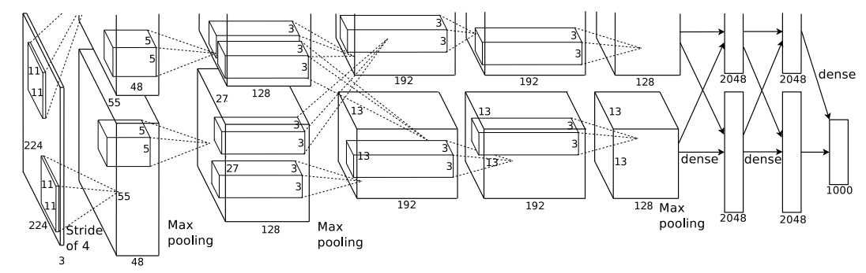
Tutorial
image classifier demo

